Slide 1
Circular economy in nuclear decommissioning
INSIDER Final Workshop
Palais des Papes, Avignon, France
16-17 September 2021
Enrico Bastianini
Security Manager

Slide 2
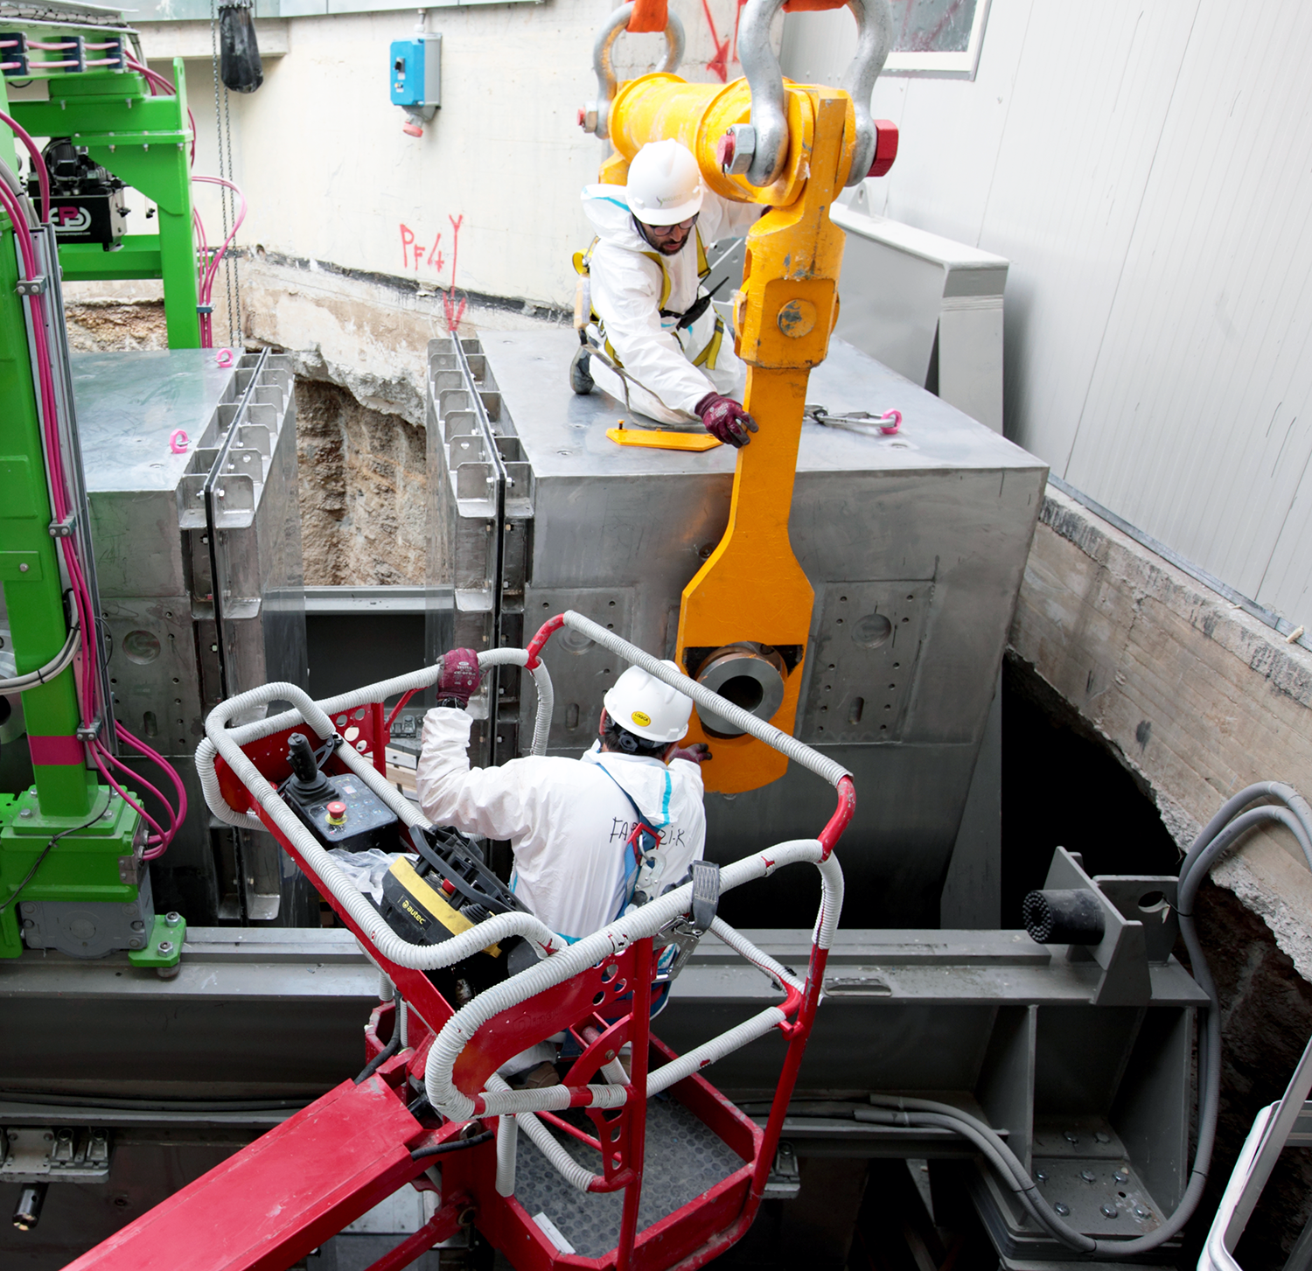
SOGIN GROUP
Sogin is the State-owned company responsible for the decommissioning of Italian nuclear plants and for the management of radioactive waste.
Sogin is also in charge of the siting, designing, building and operating of the National Repository, an environmental surface facility for the safe long-term storage and disposal of all italian radioactive waste.
On the same site of the National Repository, a Technology Park will be created.
Sogin Group
Public use

Slide 3
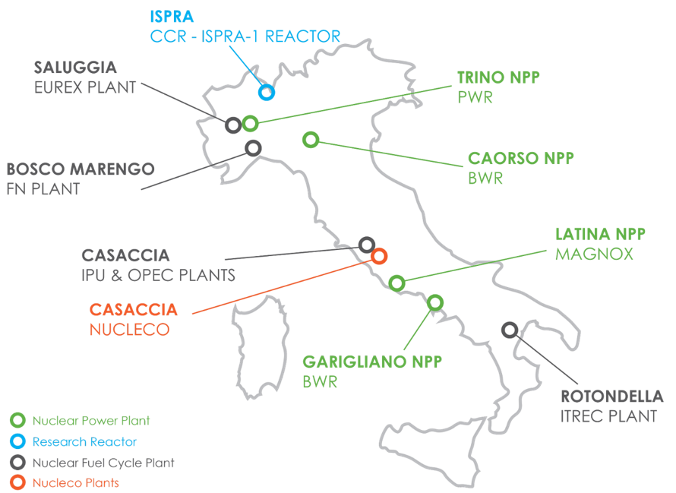
WHERE SOGIN GROUP IS IN ITALY
4 Nuclear power plants, with 3 different types of reactor (GGR – Latina; BWR – Garigliano, Caorso; PWR – Trino)
5 Nuclear fuel cycle plants
1 Research reactor
NUCLECO
The subsidiary company engaged in the integrated management of waste and radioactive sources, in the decommissioning of nuclear installations and in the decontamination of industrial sites
Sogin Group
Public use
3

Slide 4
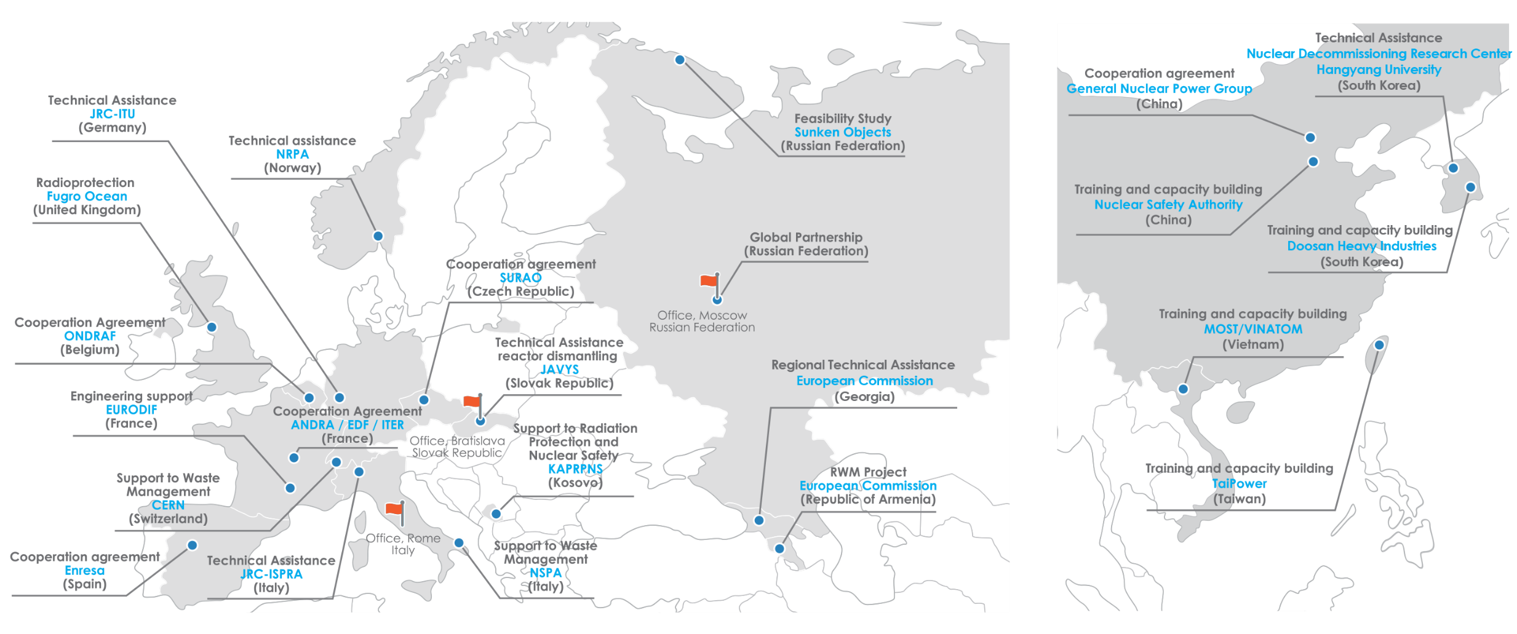
OUR INTERNATIONAL ACTIVITIES
Sogin Group
17
COUNTRIES
Public use
Notes:
Due to its expertise in the field of decommissioning and radioactive waste management, the Sogin Group has been successfully working in the international market.
Its activity is related to project implementation assistance, site characterization et cetera.
We work in other seventeen countries where we apply our experience in decommissioning, radioprotection

Slide 5
SOGIN STRATEGY FOR CIRCULAR ECONOMY
The 3 drivers underlining the circular economy applied by Sogin to nuclear decommissioning are the following:
Re-use of structures, systems and components
Material Recycling
Environmental impact reduction
The full implementation of the actions envisaged in the 3 objectives can be carried out by implementing green engineering and green public procurement policies.
GREEN ENGINEERING
Sogin circular economy strategy
1
Re-use of structures, systems and components
2
Material Recycling
3
Environmental Impact Reduction
GREEN PUBLIC PROCUREMENT
Public use
Notes:
Our circular economy strategy is based on tree pillar:
The first is the reuse of building, components and systems
The second one is the recycling of materials used in decommissioning activities.
The third is the reduction of our environmental impact.
In a trasversal way, we can find other two elements, the development of green engineering processes and the public procurement. Both aimed to support the CE strategy.

Slide 6
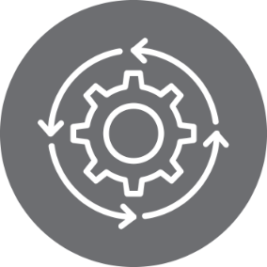
RE-USE OF STRUCTURES, SYSTEMS AND COMPONENTS
1
Safe maintenance, radioactive waste management and nuclear decommissioning activities are carried out by Sogin, up until the interim stage, in the same industrial area of the nuclear plants.
2
In many Sogin decommissioning activities, the adaptation of pre-existing buildings has resulted in the creation of temporary storage areas for radioactive waste without having to build new structures.
3
This choice led to a reduction of the amount of conventional and radioactive waste produced, it significantly reduced the need for new buildings and new raw materials, thus, encouraging further integration of waste management and nuclear power plant decommissioning process.
4
In order to optimise the use of resources, Sogin has designed movable systems and components, especially handling systems, so they can be used for similar projects in different plants.
Sogin circular economy strategy
Public use
Public Use
Notes:
Most of our activities are carried out by Sogin in the same area of NPP. With the objective to reduce the use of resources.
In most of cases we readapt existing buildings without having to build new ones. For example, some areas of the turbine buildings of Caorso and Garigliano nuclear power plants, have been intended for building new material and waste management facilities.
This choice led to reduction of conventional materials with a big result in terms of environmental impacts. An other tool that we habitually use to reach this EC objective is the realization of movable system that can be used in different sites.
This choice led also to a greater integration between the material treatment process and the decommissioning operations implemented in the nuclear island. Such integration strongly reduces workers’ radiation exposure, potential contamination risks and, consequently, environmental impacts.

Slide 7
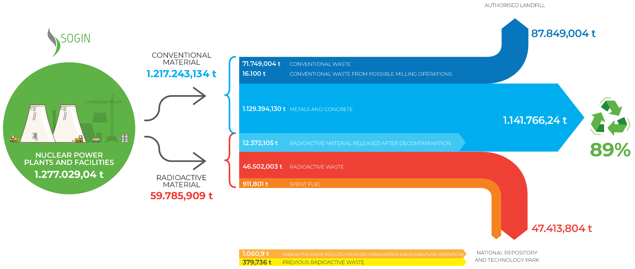
MATERIAL RECYCLING
Sogin circular economy strategy
Public use
Notes:
In this slide we can see how decommissioning activities of Sogin contribute to the circular economy.
In fact, most of materials that Sogin manages are intended to recovery.
This is the result of the application of sustainable processes and innovative technologies.
In terms of numbers, the materials that Sogin allows to recovery are more less ninty percent. They are mostly metal, copper, iron, concrete. They are produced dismantling building and facilities, like turbine, reactor, or chimney.
As this slide shows, decommissioning activities involve the use of large quantities of materials. Thanks to our approach, based on the circular economy, most of these are destined for recycling.
The Company adopted a circular economy strategy based on the minimization of radioactive waste, through the decontamination of items from radioactivity, the efficiency of energy consumption, the recovery of conventional waste and reuse of plant buildings, instead of building new ones.
The dismantling of Italian nuclear installations will allow the recovery of over one million tons of material, 89% of the total dismantled materials.
Only a small part of materials we manage is waste
Once separated from radioactive substances, materials such as copper, iron and concrete, are reused or sent for recovery. This happened with the dismantling of Caorso Off-gas Building or with Garigliano Trenches. In the first case, the demolition of civil infrastructures of the Off-Gas building in Caorso nuclear plant, previously hosting waste gas treatment systems, resulted in approx. 7,000 tonnes of (non-radioactive) concrete. Such material was partly re-used to fill the excavations resulted from the dismantling of the underground systems (former hold-up) adjacent to the building. In the second case, the materials resulted from the removal of the radioactive waste buried in the trenches were reused to refill the voids left in the excavations. In both cases, before their reuse, the materials have undergone radiological checks to assess their compliance with the release restrictions.
In other cases, the materials resulted from the dismantling operations are sent for recovery and manufacturing facilities to be later reinserted in the production chain. Overall, the decommissioning of the eight sites will allow the recycling of more than one million tonnes of materials, equal to about 89% of total dismantled materials.

Slide 8
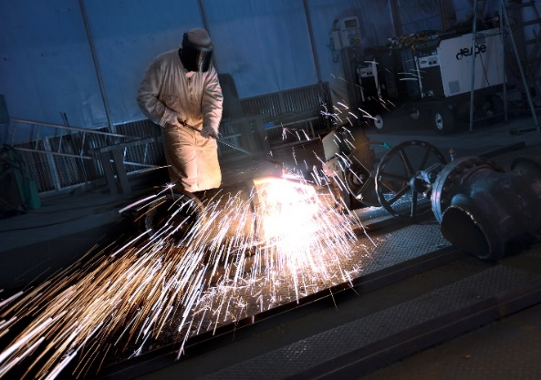
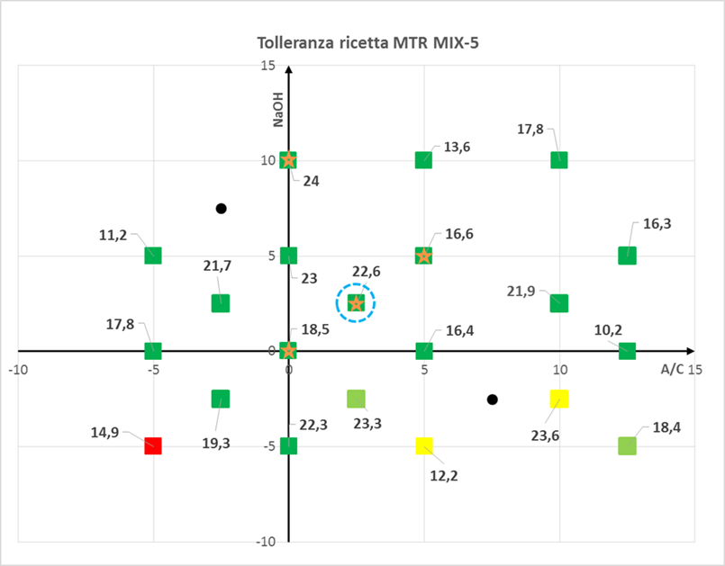
ENVIRONMENTAL IMPACT REDUCTION
The dismantling of nuclear power plants and facilities involves decontamination techniques and treatment of radioactive materials to significantly reduce the production of radioactive waste and the exploitation of raw materials.
Some examples:
Treatment of slightly contaminated metals
Sogin has selected an international partner able to separate the radioactivity content by melting the contaminated metals which come from the decommissioning of Garigliano, Latina and Trino NPPs
The activity foresees the treatment of some 1.800 t of steel, 90% of which, after separation of the radioactive part, can be recycled
Sogin circular economy strategy
New CEMEX conditioning approach
The minimization of radioactive waste is also carried out through innovative processes for the conditioning of liquid radioactive waste
In fact, a new approach on the solidification of liquid radioactive waste from Saluggia CEMEX plant, and the consequent new qualification recipe, will reduce the final waste package volume of by some 40 cubic meters
Public use
Notes:
Sogin is also involved in the implementation of processes aimed to reduce the environmental impacts.
An example of that approach concerns the treatment of contaminated metal and also a new tool for the conditioning of liquid radioactive waste. In terms of quantity it allows to reduce the total package volume of waste of by some forty cubic meters.
In this way, the remaining materials will be treated as recoverable conventional waste.

Slide 9
GREEN ENGINEERING
In addition to complying with all the security standards in terms of nuclear installations, Sogin has always given maximum importance to adopting technological production processes in all its projects and fields, aimed at minimizing total and secondary environmental impacts.
For this reason, Sogin is implementing two main approaches:
1. Use of materials that, while complying with security standards, have a lower total impact in terms of Life Cycle Assessment;
2. A change in the strategies adopted to build plants and systems, in order to minimize the environmental impacts of the whole Decommissioning and Waste Management activity.
Sogin circular economy strategy
Public use
Notes:
As shown before, the CE approach of Sogin needs to develope a green engeeniring process that is necessary to design, from the very beginning, systems that reduce the use of materials. Sometimes this approach involves a deep change of strategy, in order to minimize the impact of each activity.

Slide 10
GREEN PUBLIC PROCUREMENT
Green Public Procurement (GPP) is defined by the European Commission as "a process whereby public authorities seek to procure goods, services and works with a reduced environmental impact throughout their life cycle when compared to goods, services and works with the same primary function that would otherwise be procured".
The proper management of procurement is for Sogin an important driver and an additional tool for the reduction of environmental impacts, thereby promoting sustainable development. GPP represents a lever on which to base an effective application of the circular economy.
Sogin circular economy strategy
Public use
Notes:
The same approach is applied by Sogin in the relationships with suppliers. In fact, Sogin , often in a voluntary way, chooses the suppliers that are attentive in order to be sustainable . For example, Sogin is implementing the so called environmental criteria, established by Italian law. They are social, environmental and economic requirements, aimed at guiding the choices of the Public Administration in a sustainable way. Their systematic and homogeneous application also allows to increase the involvement and commitment of contractors in the CIRCULAR ECONOMY process.

